Slide 1
Block level and inline elements

Slide 2

HTML Block and Inline Elements
Every HTML element has a default display value depending on what type of element it is. The default display value for most elements is block or inline.
A block-level element always starts on a new line and takes up the full width available (stretches out to the left and right as far as it can).
An inline element does not start on a new line and only takes up as much width as necessary.

Slide 3
HTML Block and Inline Elements
Example Block Elements:
<p> , <pre> , <table> , <ul> , <ol>, ...
Example Inline Elements:
<img> , <a> , <b> , <strong> , <small>

Slide 4
BLOCK LEVEL ELEMENTS
.
Examples <h1> through <h6>, <p>,<ul>,<table>,<div>,<pre><address><article> etc
An example of the block-element is the <div> element that can act as the container for other HTML documents. The commonly used attributes with it are style, id, and class.

Slide 5
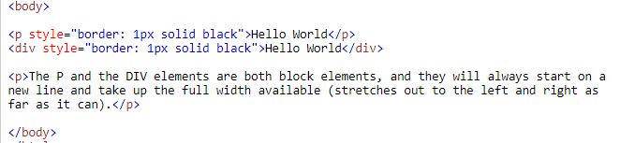
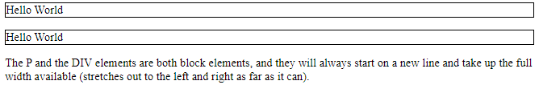
Block level elements example

Slide 6
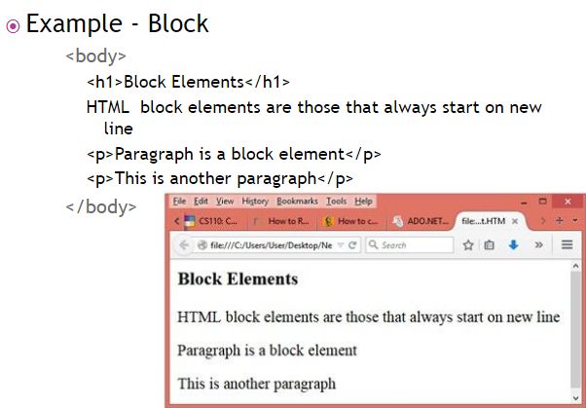

Slide 7
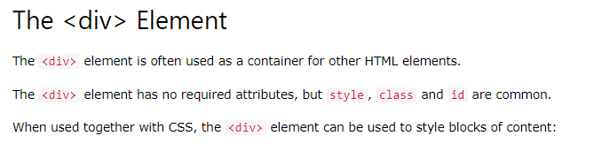

Slide 8
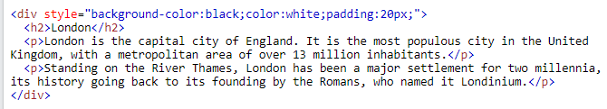
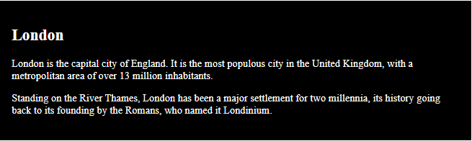
Div element with style attribute

Slide 9

Div element with style attribute
We want to get

Slide 10
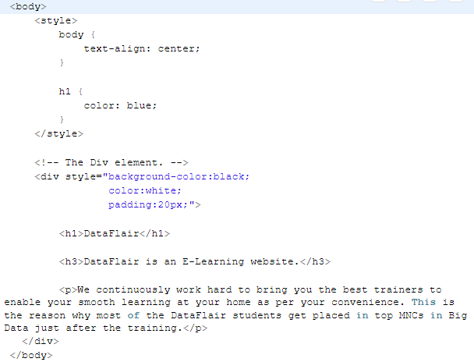
Div element with style attribute

Slide 11
Classes and IDs
HTML has two attributes that make CSS even more useful: class and ID. They make it easy to apply style to just about any tag.
Classes can describe a generic style that can be applied to any HTML element, or can be created for specific elements.
When defining a style for elements with a particular class attribute in the Style Sheet, declare a rule using a dot (.) followed by the class name. .
The following rule would apply to any element with the attribute class=“shade"
.shade { background: yellow; }
The following rule would apply only to paragraph tags with the class shade (<p class="shade">)
p.shade { background: red; }

Slide 12
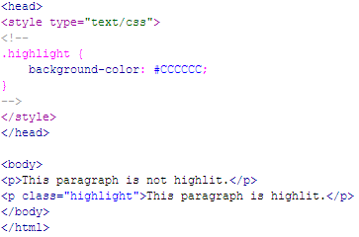

Class example
Here’s an example of a web page with an internal CSS style with a class called “highlight”:

Slide 13
HTML class attribute
The HTML class attribute is used to specify a class for an HTML element.
Multiple HTML elements can share the same class.
The class attribute is often used to point to a class name in a style sheet.
It can also be used by a JavaScript to access and manipulate elements with the specific class name.

Slide 14
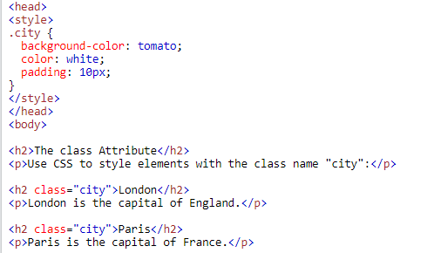
Syntax for class

Slide 15
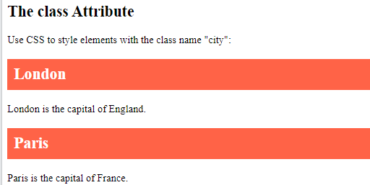

Slide 16
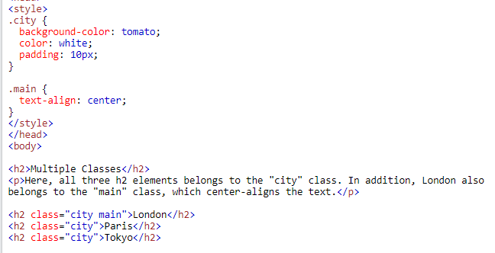

Multiple classes

Slide 17
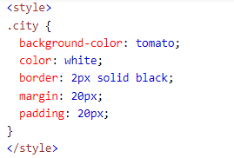

Div element as class

Slide 18
Html id attribute

Slide 19
The HTML id attribute is used to specify a unique id for an HTML element.
You cannot have more than one element with the same id in an HTML document.

Slide 20
The syntax for id is: write a hash character (#), followed by an id name. Then, define the CSS properties within curly braces {}.
The id name is case sensitive!
The id name must contain at least one character, cannot start with a number, and must not contain whitespaces (spaces, tabs, etc.).

Slide 21
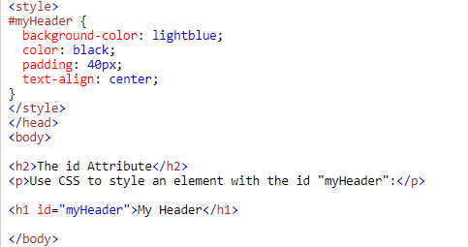
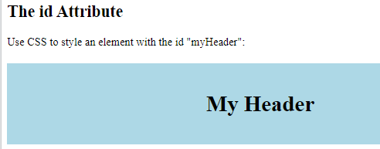
Example of id attribute

Slide 22
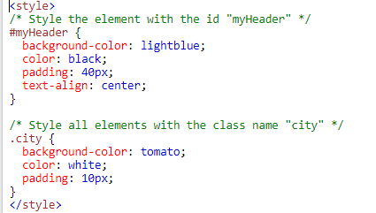
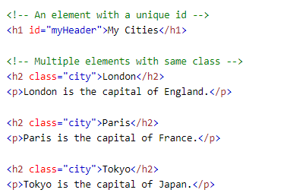
Difference between class and id
A class name can be used by multiple HTML elements, while an id name must only be used by one HTML element within the page

Slide 23
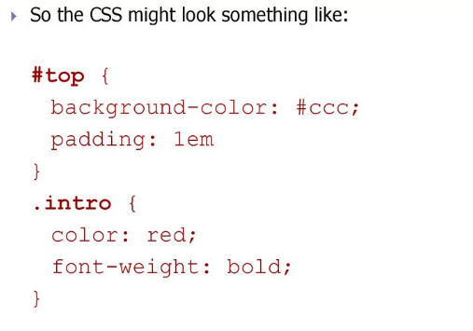
Class and id selectors

Slide 24
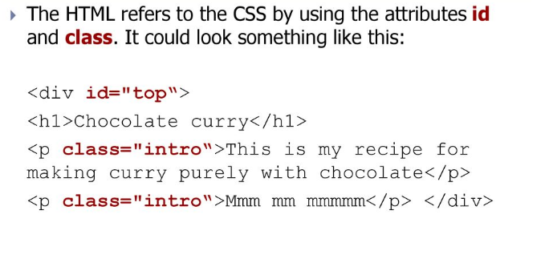
Class and id selectors

Slide 25
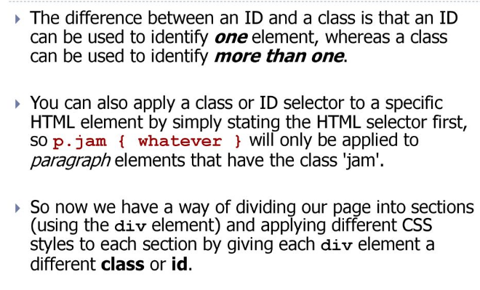

Slide 26
Universal selector
The universal selector (*) selects all HTML elements on the page
<style>
* {
text-align: center;
color: blue;
}
</style>

Slide 27
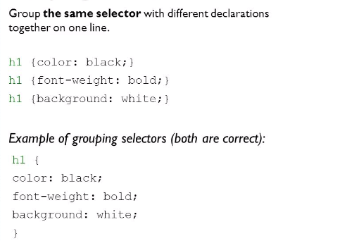
CSS GROUPING SELECTOR

Slide 28
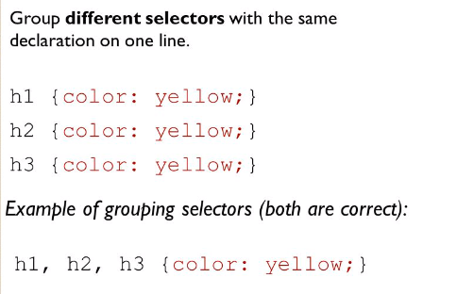
CSS GROUPING SELECTOR

Slide 29
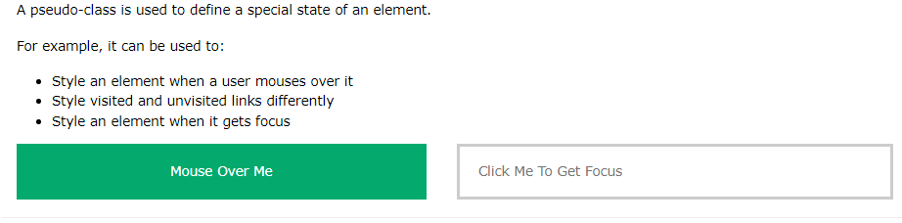
CSS PSEUDO SELECTOR
A pseudo-class is used to define a special state of an element.
For example, it can be used to:
Style an element when a user mouses over it
Style visited and unvisited links differently
Style an element when it gets focus

Slide 30
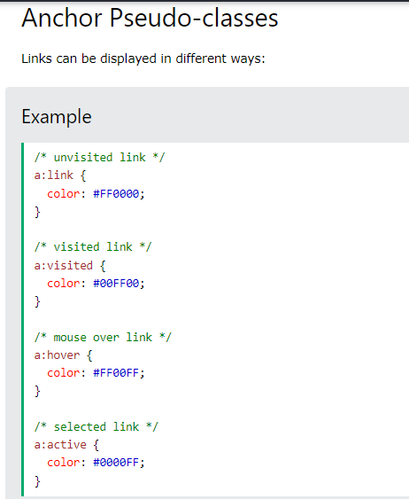

Slide 31
Inline elements
An inline element does not start on a new line.
Inline elements are normally displayed without breaks
An inline element only takes up as much width as necessary.
example <b><td><img><a><span> etc

Slide 32
